Slide 1
Welcome to Universal Communications…
Visit us - www.universalcomm.co.in Email : info@universalcomm.co.in

Slide 2
Company Profile…
We at “UNIVERSAL COMMUNICATIONS” introduce ourselves as the leading distributor of telecommunication & Office Automation Equipment's in Nashik. We supply, install and provide after sales service for all these products. Our Organization is having the existence of more than ten years in the Telecommunication & Office Automation Products at Nashik. We had installed more than 3500 EPABX SYSTEM throughout Maharashtra. In Nasik we had claim more than 60% share in market.
Visit us - www.universalcomm.co.in Email : info@universalcomm.co.in

Slide 3
Products and Services…
CCTV CAMERA SYSTEM (ANALOG AND IP)
SECURITY SYSTEM(WIRED AND WIRELESS)
VIDEO DOOR PHONE (INDIVIDUAL AND MULTI APPARTMENT)
TIME AND ATTENDANCE SYSTEM
ACCESS CONTROL SYSTEM
BOOM BARRIERS
FENCE INTRUSION DETECTION SYSTEM
GUARD MONITORING
VEHICLE TRACKING SYSTEM
METAL DETECTOR
EPABX/INTERCOM
MOBILE JAMMER
LEASED LINE
CURRENCY COUNTING MACHINE
ELECTRONIC HOME SAFE
MIXING AMPLIFIERS
Visit us - www.universalcomm.co.in Email : info@universalcomm.co.in

Slide 4
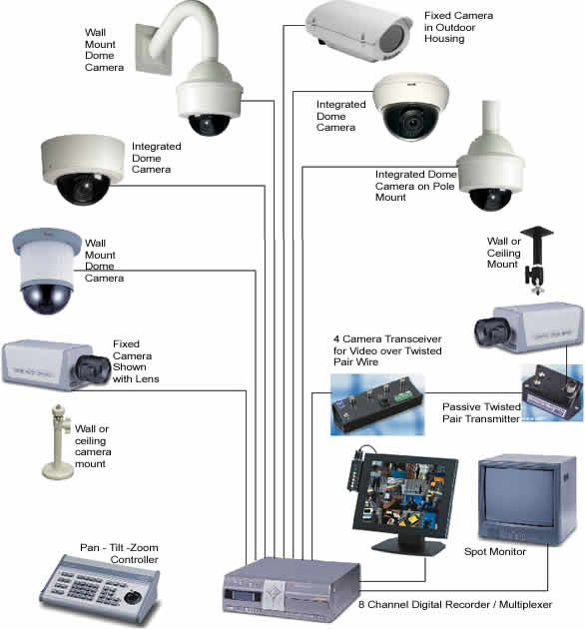
CCTV Camera System…
DVR
Simple Dome Camera
IR Dome camera
IR Bullet camera
PTZ Camera
PTZ controller
Visit us - www.universalcomm.co.in Email : info@universalcomm.co.in

Slide 5
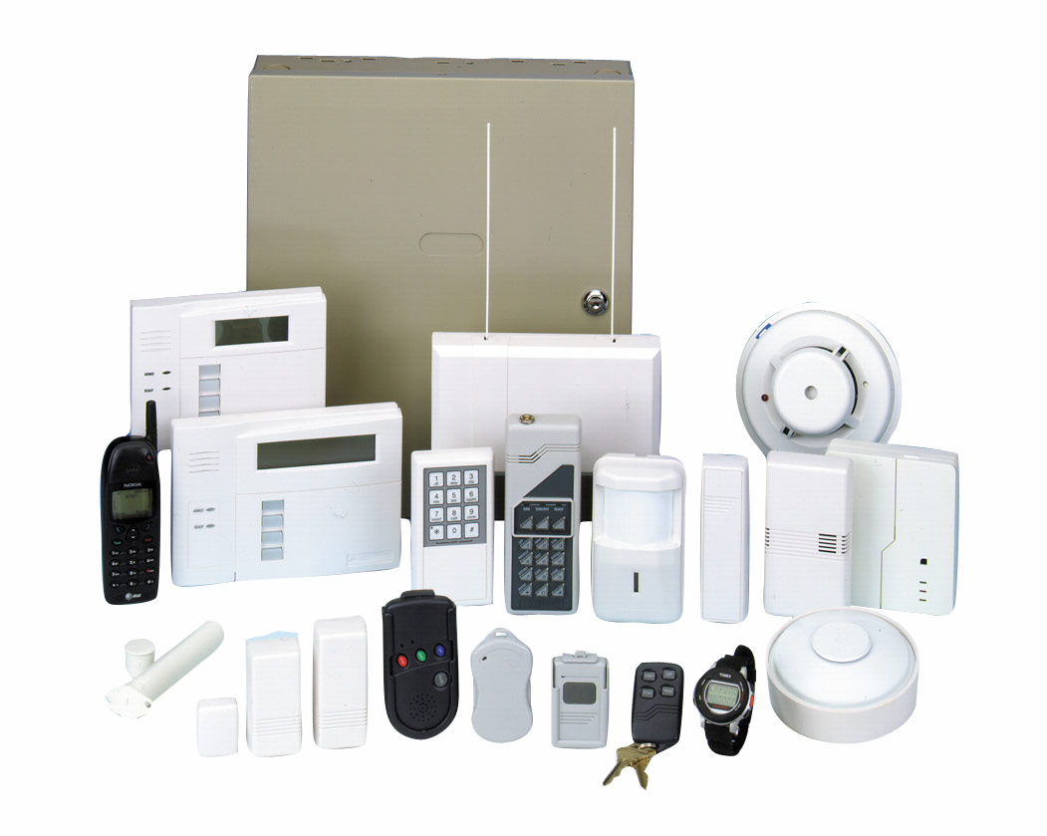
Security System…
Control panel
Motion sensor
Door sensor
Shutter sensor
Smoke detector
Emergency switch
Siren
Automatic mobile calling
Visit us - www.universalcomm.co.in Email : info@universalcomm.co.in

Slide 6
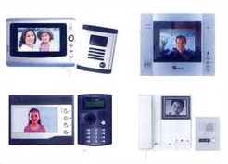
Video Door Phone…
LCD display
Out door camera
Lobby phone
Electro magnetic door lock
Visit us - www.universalcomm.co.in Email : info@universalcomm.co.in

Slide 7
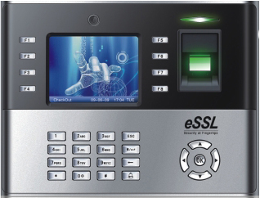
Time and Attendance System…
Time and attendance machine
Time and attendance software
Proximity card and finger punch available
Visit us - www.universalcomm.co.in Email : info@universalcomm.co.in

Slide 8
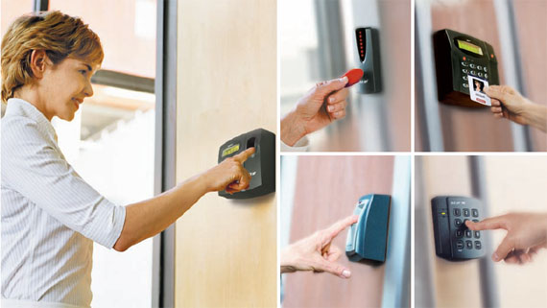
Access Control System…
Access control device
Electro magnetic door lock
Punching card and finger punching available
Visit us - www.universalcomm.co.in Email : info@universalcomm.co.in

Slide 9
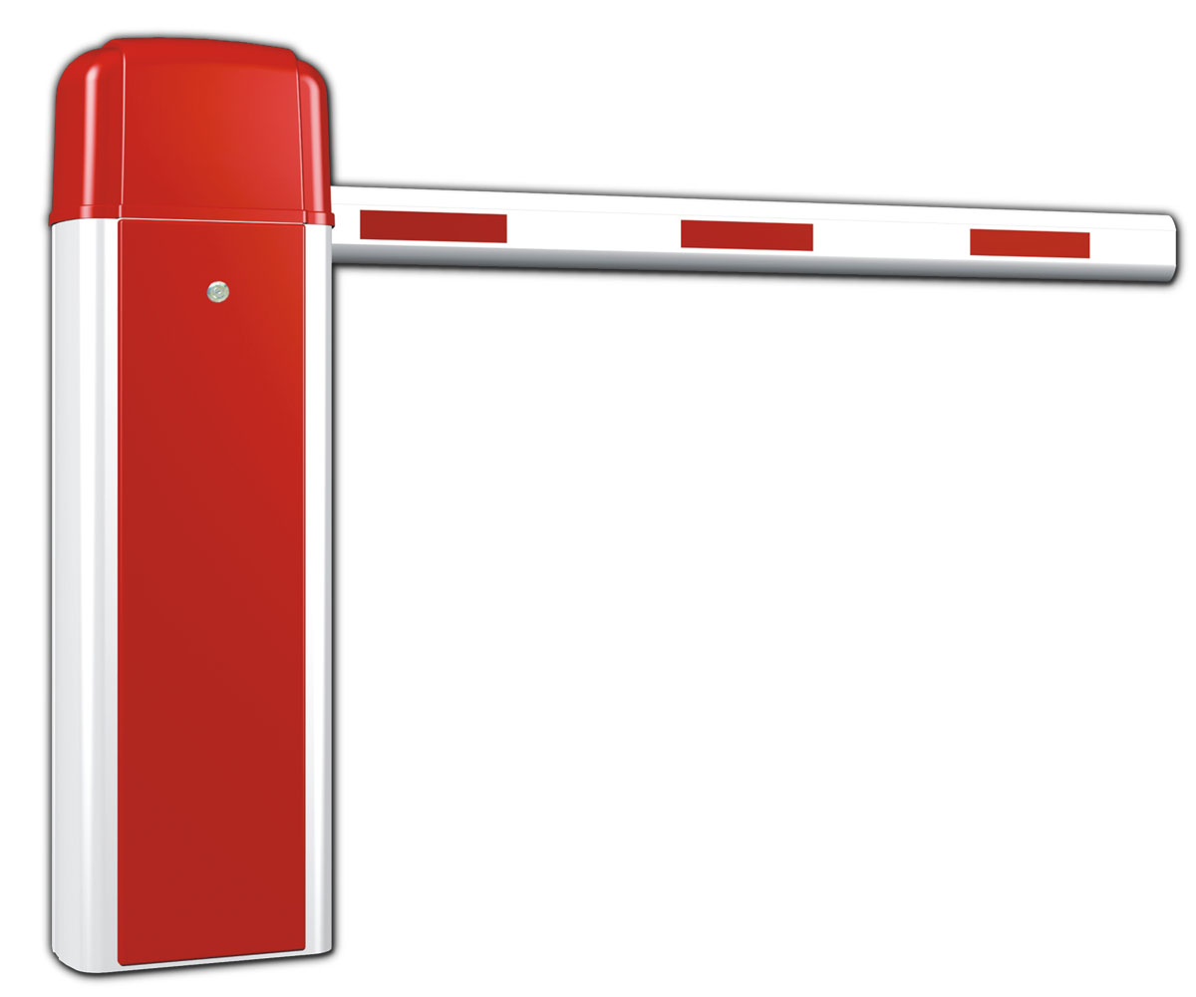
Boom Barriers…
Boom barrier
Centralized control button
Visit us - www.universalcomm.co.in Email : info@universalcomm.co.in

Slide 10
Fence Intrusion Detection System…
Control panel with display
Transmitters
Receivers
hooter
Visit us - www.universalcomm.co.in Email : info@universalcomm.co.in

Slide 11
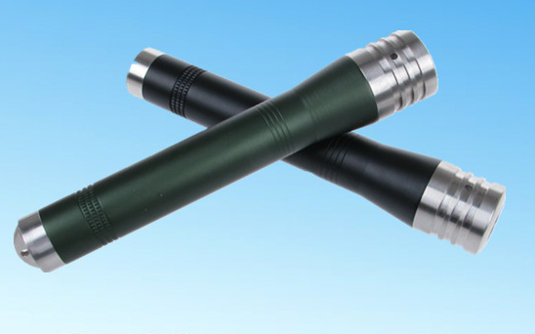
Guard Monitoring…
Data acquisition reader
Data acquisition base
Remote storage and communicator station
System software
Visit us - www.universalcomm.co.in Email : info@universalcomm.co.in

Slide 12
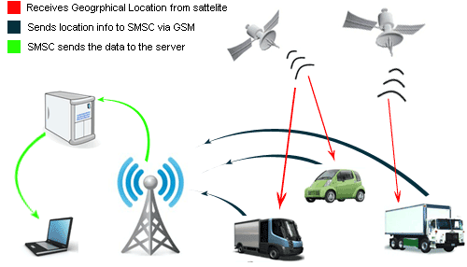
Vehicle Tracking System…
Transmitter device
System software
Visit us - www.universalcomm.co.in Email : info@universalcomm.co.in

Slide 13
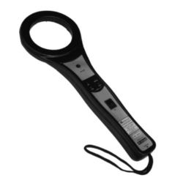
Metal Detector…
Hand held metal detector
2,4,6 channel metal detector
Visit us - www.universalcomm.co.in Email : info@universalcomm.co.in

Slide 14
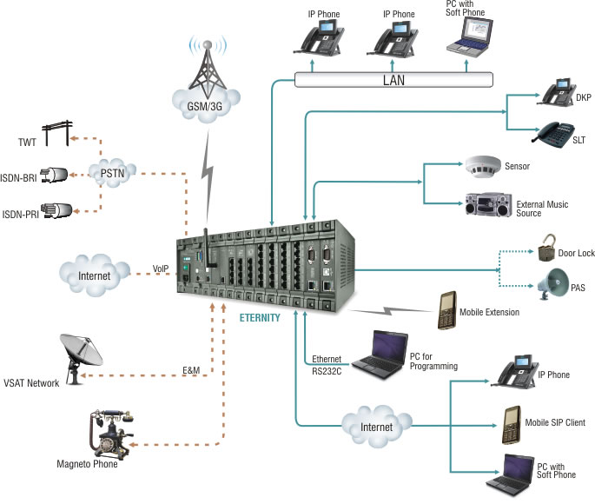
EPABX / Intercom…
EPABX
Phone
Visit us - www.universalcomm.co.in Email : info@universalcomm.co.in

Slide 15
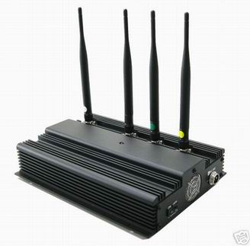
Mobile Jammer…
Mobile jammer device
Visit us - www.universalcomm.co.in Email : info@universalcomm.co.in

Slide 16
Contact …
UNIVERSAL COMMUNICATIONS
Shop No. 9, Anudeep Park, Near Chandak Circle,
Tidke Colony, Nashik - 422 002.
Phone: +91 253 2314784 / 2314754 / 2319149
E Mail: info@universalcomm.co.in
Pune Branch
Sr. No 60/4/A , Sanjivani Kunj, NR Pune-Banglore High Way Bapass, Dangat-Patil Nagar, Wadgoan-BK, PUNE- 41
Director: Mr. Ashok Rahane
Mobile: +91 98230 58721
E Mail: ashokrahane@universalcomm.co.in
Visit us - www.universalcomm.co.in Email : info@universalcomm.co.in

Slide 17
Visit us - www.universalcomm.co.in Email : info@universalcomm.co.in

